Slide 1
Crafting A Climate Science Classroom Strategy For Dealing With Cultural Identities
Peter Buckland
Postdoctoral Fellow, Sustainability Institute
Penn State

Slide 2
Today
Me
The email
“Resolved: Climate change is not a ‘crisis’”

Slide 3
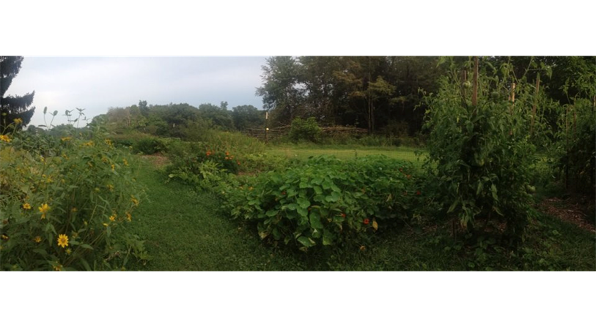
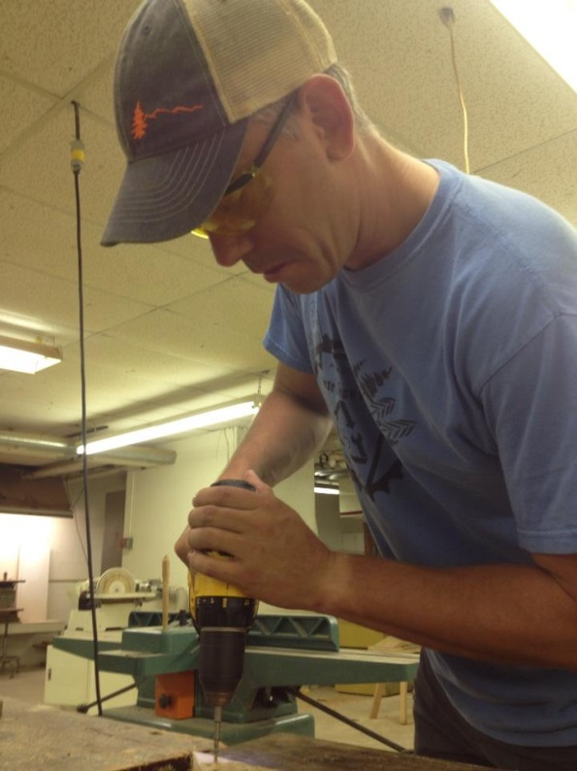
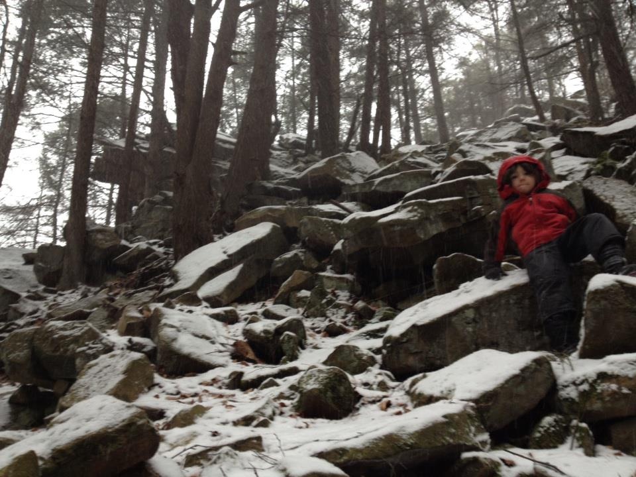
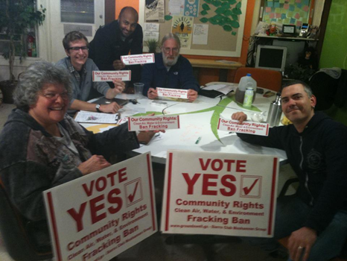
Who am I?
Notes:
I knew I needed to get into the practice of sustainability on the doing end much more. Working with operations. Working with administration. Working with teachers. Working as a teacher and producer.

Slide 4
Ecology Class at Kiski
Course Purposes
SCIENTIFIC KNOWLEDGE: I designed the course for ecological concept mastery which requires developing literacy of scientific methods, philosophy of science, sociology of science, and knowledge discovered through the scientific enterprise.
DEMOCRATIC CITIZENSHIP: Create possibilities for my students to become better ecological citizens, people who “recognizes the importance and interconnectivity of all living beings, human and non-human...[who] understands that she or he is responsible to all beings and actively seeks sustainable futures for them” (Kissling and Barton, 2013).
To my mind this required:
Accuracy of scientific information and discourse.
Opportunities to develop their own views on the matter regarding risk and moral evaluations.
Forums to discuss different points of view.

Slide 5
The dreaded parent…
Dear Mr. Buckland,
I am…

Slide 6
Climate change belief

Slide 7
Concerns: Climate change & its discounters

Slide 8
Climate change & its discounters
The Doubtful (13%) are uncertain whether global warming is occurring or not, but believe that if it is happening, it is attributable to natural causes, not human activities. They tend to be politically conservative and to hold traditional religious views.
The Disengaged (9%) have given the issue of global warming little to no thought. They have no strongly held beliefs about global warming, know little about it, and do not view it as having any personal relevance. They tend to have the lowest education and income levels of the six groups.
Dismissive (8%), who are very certain that global warming is not occurring. Many regard the issue as a hoax and are strongly opposed to action to reduce the threat. About one in nine have contacted an elected representative to argue against action on global warming.
Yale Project on Climate Change Communication, Global Warming’s Six Americas, September 2012

Slide 9
Cultural Cognition
“Cultural cognition refers to the tendency of individuals to fit their perceptions of risk and related factual beliefs to their shared moral evaluations of putatively dangerous activities. The cultural cognition thesis asserts that individuals are psychologically disposed to believe that behavior they (and their peers) find honorable is socially beneficial, and behavior they find base socially detrimental.”
Kahan, Braman, & Jenkins-Smith. Cultural Cognition of Scientific Consensus. Journal of Risk Research.

Slide 10
Cultural Cognition Framework: Risk. Risk. Risk.

Slide 11
Motivated Reasoning
“The unconscious tendency of individuals to process information in a manner that suits some end or goal extrinsic to the formation of accurate beliefs. ”
“They Saw a Game” example
~Dan Kahan, Cultural Cognition Project of the Yale Law School
On climate change this will mean we will…

Slide 12
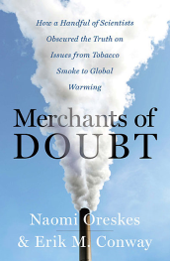
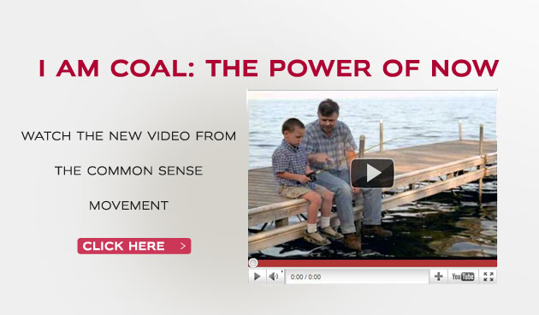
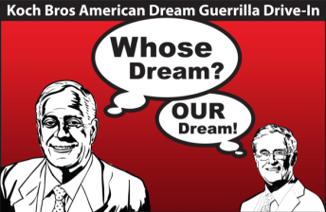
Motivated Reasoning

Slide 13
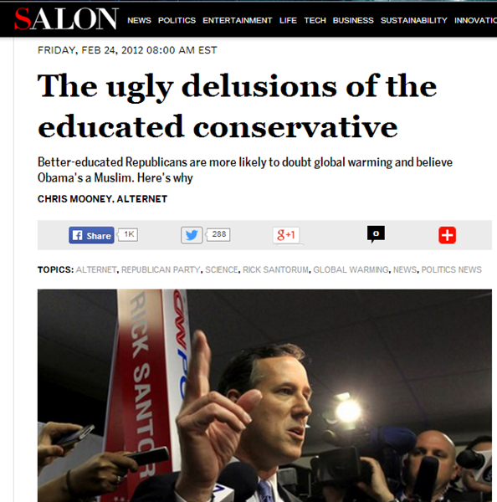
Cultural Cognition and Motivated Reasoning
Motivated Reasoning & Smart Idiots
“What accounts for the “smart idiot” effect?” Chris Mooney, The Republican Brain 1. News & information consumption.
2. Familiarity with claims & counterarguments.
3. Threats to identity/ies.
4. The desire to argue and protect whatever is threatened.
Chris Mooney, The Republican Brain

Slide 14
Science Literacy & Ecological Citizenship
1. KNOWLEDGE
2. CITIZENSHIP
THERE WOULD BE CONFLICTS BETWEEN MY GOALS AND MY STUDENTS’ IDENTITIES. HOW COULD I GET AROUND THEM?
THE EMAILING PARENT PRESENTED ME WITH A CHALLENGE

Slide 15
The dreaded parent…
Dear Mr. Buckland,
I am…
Dear Mr. Kiskidad,
I am…
not the arbiter of your son’s values.

Slide 16
Strategy: Careful Deliberation
“Open-minded public engagement with scientific information requires a deliberation environment in which no group of citizens is forced to see assent to sound evidence as hostile to its defining commitments. In cultivating such an environment for deliberations over the problem of climate change, the diverse cultural resonances associated with the full range of potential responses is a resource to be exploited in science communication.” [Emphasis mine.]
Kahan et al, “Geoengineering and Climate Change Polarization: Testing a Two-channel Model of Science Communication.” Annals of American Academy of Political & Social Sci.

Slide 17
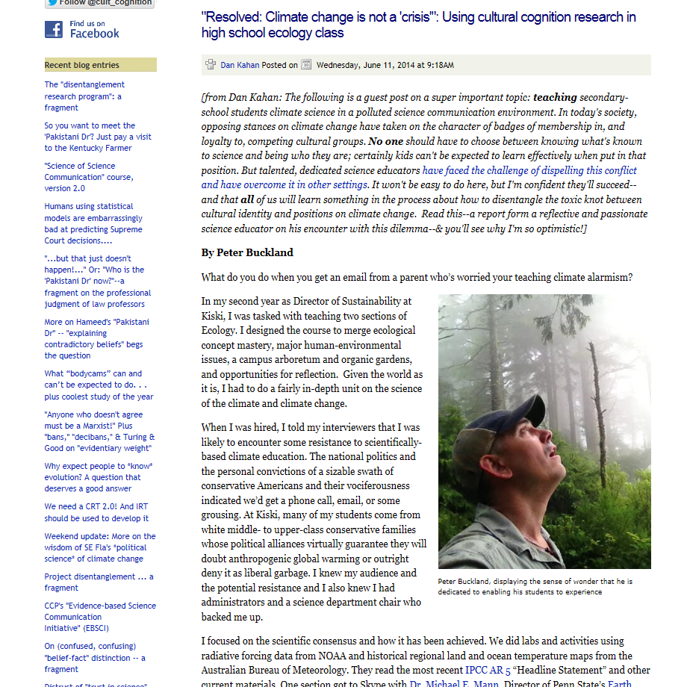
“Resolved: Climate change is not a ‘crisis’”

Slide 18
Strategy: Intelligence Squared Debate
The series is based on the traditional Oxford-style debate format, with one side proposing and the other side opposing a sharply-framed motion.

Slide 19
Why this format? Risk. Risk. Risk.
Strengths
Not “Is climate change real? Yes or no?” Hoax arguments fenced out and emphasis on established peer-reviewed science through secondary sources and other vetted sources (World Bank, IEA, IPCC, Science Daily).
By using “not a crisis” avoid the affirmation of the “Alarmed” position.
Equal numbers of students would be on one side or the other. Deliberate assignment into one group or another put the Alarmed into Cautious or Discounter positions and vice versa.
I avoided language about being “objective,” “rational,” “unbiased,” or “open-minded” because such language prompts more motivated reasoning.
Potential Pitfalls
Editing could out hoax arguments is a form of censorship.
“Far from counteracting [cultural entrenchment], deliberation among diverse groups is likely to accentuate polarization. By revealing the correlation between one of another position and one or another cultural style, public debate intensifies identity-protective pressure on individuals to conform to the views dominant within their group.”

Slide 20
Results
“…not a crisis.”
Compared to other things like wars (Crimea and Syria as examples), global poverty (African examples), or AIDS pandemic (Africa again), climate change is not a crisis.
Technological optimism for advances in solar technology that will displace fossil fuel technologies (Ray Kurzweil)
“…is a crisis.”
Insurance and reinsurance costs are rising as more intense storms, droughts, heatwaves, and floods and rising sea levels do more damage to human and natural systems.
Threats to the carbon cycle have already been so severe that major disruptions to ecosystem services and biodiversity are present and accelerating.

Slide 21
Results: Exploration of risk perception.
“…not a crisis.”
Compared to other things like wars (Crimea and Syria as examples), global poverty (African examples), or AIDS pandemic (Africa again), climate change is not a crisis.
Technological optimism for advances in solar technology that will displace fossil fuel technologies (Ray Kurzweil)
“…is a crisis.”
Insurance and reinsurance costs are rising as more intense storms, droughts, heatwaves, and floods and rising sea levels do more damage to human and natural systems.
Threats to the carbon cycle have already been so severe that major disruptions to ecosystem services and biodiversity are present and accelerating.

Slide 22
Ecology Class at Kiski
Course Purposes
SCIENTIFIC KNOWLEDGE: I designed the course for ecological concept mastery which requires developing literacy of scientific methods, philosophy of science, sociology of science, and knowledge discovered through the scientific enterprise.
DEMOCRATIC CITIZENSHIP: Create possibilities for my students to become better ecological citizens, people who “recognizes the importance and interconnectivity of all living beings, human and non-human...[who] understands that she or he is responsible to all beings and actively seeks sustainable futures for them” (Kissling and Barton, 2013).
To my mind this required:
Accuracy of scientific information and discourse.
Opportunities to develop their own views on the matter regarding risk and moral evaluations.
Forums to discuss different points of view.

Slide 23
The Future
Is it possible to devise teaching and communication strategies that increase science literacy without forcing people to choose between what they know and who they are?
Is that a good goal when so many are so alarmed? Are there times when forcing that choice on students and the public is more important than not when a risk is really high? Is that time now? Is it moral?
Can we devise teaching and communication strategies that sidestep one part of who someone to get at another part of who they are?

Slide 24
Two Projects
Improving the Science of Climate Change and Evolution Education (ISCCEE)
PIs:
David Long, George Mason
Dan Kahan, Yale University
Connie Bertka, Smithsonian
Facilitators:
Peter Buckland, Penn State
Tim Brown, Yale
Joseph Henderson, Rochester
Brianna Pobbiner, Smithsonian
Pennsylvania Environmental Risks Communication Initiative
Based on some unpublished work on communities threatened by sea level rise, can we use place-based or activity-based identities to increase scientific literacy and civic action on climate-related issues?
In Pennsylvania what opportunities are there? Black-legged ticks and Lyme disease? Tiger mosquitoes and West Nile virus?

Slide 25
Questions?
Peter Buckland
Penn State
Sustainability Institute
pdb118@psu.edu

